Slide 1
All About Osteoporosis
Bone health, fragile bones and fractures
2015
Notes:
All about osteoporosis
This presentation aims to tell you all about osteoporosis.
It will address the key subject areas of bone health, fragile bones and fractures.

Slide 2
All about osteoporosis
What is osteoporosis?
What are the consequences?
Finding out if your bones are fragile
Healthy living for strong bones
Drug treatments to prevent fractures
Help after fragility fractures
Notes:
All about osteoporosis
During this talk we are going to discuss:
What osteoporosis is and how it leads to fragile bones that break easily
The significant impact for individuals affected and for health and social care services
How osteoporosis and fragile bones can now be identified and which risks are most significant
The important lifestyle changes which can build strong bones and make fractures less likely
The effective drug treatments that can now be offered to those at a high risk of fractures, and in the final section
What strategies are available to help with pain and disability after fractures.

Slide 3
What is osteoporosis?
Bones are fragile and more likely to break (or fracture) easily
Fractures = broken bones
Fragility fractures occur with minimal trauma
Fractures can lead to pain, changes in body shape and disability
Notes:
What is Osteoporosis?
Osteoporosis is a condition when bones are fragile and more likely to break easily
Just as a point of information: fractures and broken bones mean the same thing and both terms will appear during this presentation. Some people get confused and assume ‘fractures’ are different and perhaps more serious
With osteoporosis, these fractures occur easily without excessive force or trauma. In fact if a fracture occurs after falling from a standing height this suggests bones are fragile. These fractures are referred to as ‘fragility fractures’
An important point to remember is that it is fractures that cause the pain; changes in the shape of the spine and the disability associated with osteoporosis. Osteoporosis in the absence of fractures gives no symptoms

Slide 4
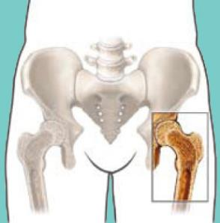
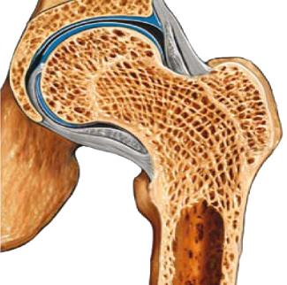
How our bones work
Periosteum
Pelvis
Cartilage
Spongy bone
Structural support for body and protection of organs
Store for calcium and other minerals
Movement
Blood cell production
Medullary cavity
Compact bone
Femur (thigh bone)
Notes:
How our bones work
Before we look at what happens when bones are affected by osteoporosis it is helpful to understand something about the structure and function of normal bones.
The bones in our skeleton have many different important functions:
They provide a structure for the body protecting all the organs within it
Bones store calcium and many other minerals used by the body - 99% of calcium is found in the bones with 1% circulating and helping muscles and nerves to work effectively
Bones provide attachments for the tendons of the skeletal muscles and the ligaments of the joints. The bones act as levers and pulleys translating muscle contraction into movement
Bone marrow fills the cavities within the bone and produces red and white blood cells to fight infection and transport oxygen around the body
The outer protective membrane of the bone is called the periosteum. It contains sensitive nerve endings
The outer shell of the bone is called cortical or compact bone
Inside and especially at the ends of long bones and in the spinal bones there is a mesh of spongy bone creating a light but strong structure. This is termed trabecular or cancellous bone.

Slide 5
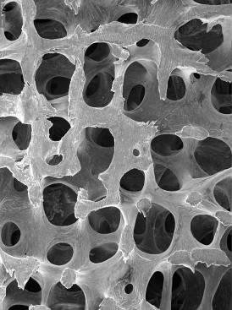
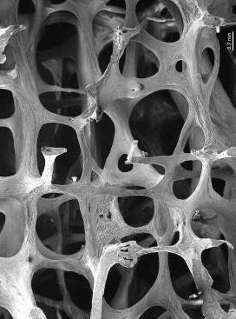
Healthy bone
Osteoporotic bone
Notes:
Osteoporotic bone
This slide shows what bone looks like when viewed under a microscope; with healthy bone on the left and osteoporotic bone on the right.
When bones become osteoporotic and fragile, the cortical bone (the outer shell) thins and the struts within the trabecular bone (inner mesh) also narrow and become less strong.
Eventually the architecture within the trabecular structure breaks down, leading to loss of bone strength and an increased risk fracture.

Slide 6
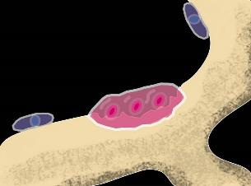
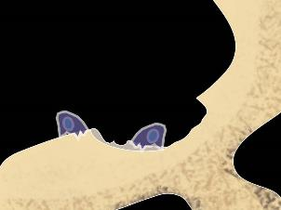
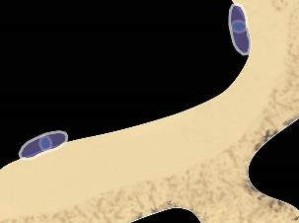
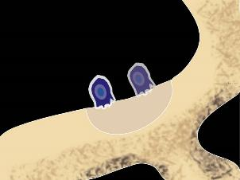
The Living Skeleton
Notes:
The Living Skeleton
Bone is a living tissue that is constantly changing or ‘remodelling’ throughout life
Old worn out bone is broken down by specialist cells called ‘osteoclasts’ and replaced by bone building cells called ‘osteoblasts’ in a process of renewal called ‘bone turnover’
During childhood it takes the skeleton just two years to completely renew itself. In adults this process takes seven to ten years
Slide top left shows osteoclasts wearing away the surface of bone and creating a cavity
Slide top right shows osteoblasts creating new bone
Slide bottom right shows new bone filling up the cavity
Slide bottom left shows bone resting before the process starts again

Slide 7
Changes in bone mass with age
Genes
Nutrition
Exercise
Nutrition?
Vitamin D in the
womb
Peak bone mass
Age related bone loss
Reduced physical activity
Men
Menopause
Bone mass
Women
0 10 20 30 40 50 60 70 80
Age (years)
Adapted from J Compston 1990
Notes:
Changes in bone mass
This slide shows how bone mass changes throughout life:
Bone mass – the total amount of bone tissue that we have - increases up until early adult life
Such bone, known as ‘peak bone mass’ stays relatively stable until our mid thirties when the proportion of bone loss begins to exceed the new bone produced
This imbalance becomes significant in women at the menopause when bone loss occurs at a rate of up to 5% a year
It occurs also, albeit at a slower rate, in both men and women with increasing age
This graph shows the normal pattern of bone loss with age and the different factors that play a part.
Lifestyle factors such as nutrition and exercise as well as our genetic make up will affect the amount of bone laid down in our early years and the pattern of bone loss in later life
Studies are beginning to identify the importance of adequate nutrition and vitamin D even in the womb

Slide 8
Notes:
Consequences of osteoporosis
As mentioned earlier, fragility fractures are the only significant consequence of osteoporosis
It is these fractures or broken bones that that can be painful and disabling
In the UK it is estimated that the lifetime risk of sustaining a fracture from the age of 50 is 1 in 2 women and 1 in 5 men- many of these as a result of poor bone health
Fragility fractures are generally more common in old age and most hip fractures occur after the age of 75 years
van Staa TP, Dennison EM, Leufkens HG and Cooper C., (2001) Epidemiology of fractures in England and Wales. Bone 29: 517-522.

Slide 9
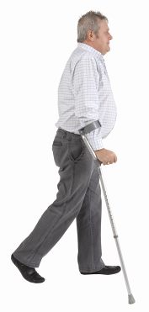
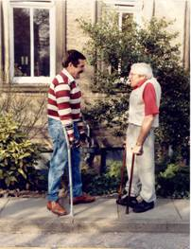
Fractures caused by bone fragility affect 1 in 5 men
Notes:
Osteoporosis in men
Although osteoporosis is associated with women it commonly affects men too as they age
Sometimes younger men are affected, usually because of the effects of another medical condition or a medication although sometimes no reason is identified.
Bob Reece, shown here on the right, was in his 40s when he began to experience spinal compression fractures and rib fractures – sometimes with severe pain and hospitalisation. No reason for his osteoporosis has been discovered.

Slide 10
Less common types of osteoporosis
Osteoporosis in children
Osteoporosis associated with pregnancy
Notes:
Less common types of osteoporosis
There are some less common forms of osteoporosis.
Osteoporosis in children . Idiopathic juvenile osteoporosis (IJO) is an unusual condition in young people where broken bones occur spontaneously without an apparent underlying condition.
Sometimes osteoporosis occurs in children because of other factors such as taking corticosteroid medicines; the brittle bone disease (osteogenesis imperfecta) or because a child has another medical condition resulting in immobility.
‘Osteoporosis associated with pregnancy’ is a rare condition when bones break unexpectedly, usually in the spine or hip, during or after pregnancy

Slide 11
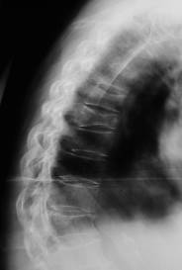
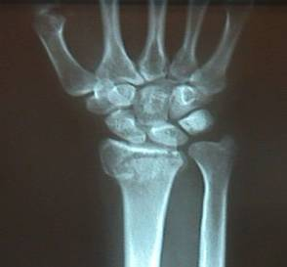
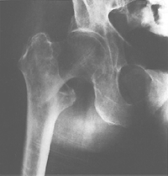
Common fracture sites
Wrist
Compressed
vertebrae
in spine
Hip
Notes:
Common fracture sites
The most frequent fractures linked with osteoporosis are of the wrist and spine and hip although probably most fractures in older people are at least in part related to osteoporosis
Wrist fractures are not always disabling although they can be - especially for someone living alone
Wrist fractures tend to occur at a younger age than hip or spine fractures and can be an early signal that an individual may have fragile bones
Vertebral compression fractures (as indicated by the red arrow) differ from other common ’breaks’ in the bone in that they are not usually a consequence of a fall and may occur following routine daily activities such as bending or lifting
Affected vertebrae can become flattened, squashed down or wedge shaped
Although fractures heal, the spinal bones do not return to their original shape
It is these changes in vertebral shape that cause shortening of the trunk; loss of height and curvature of the spine
Hip fractures commonly affect older people and severely reduce quality of life

Slide 12
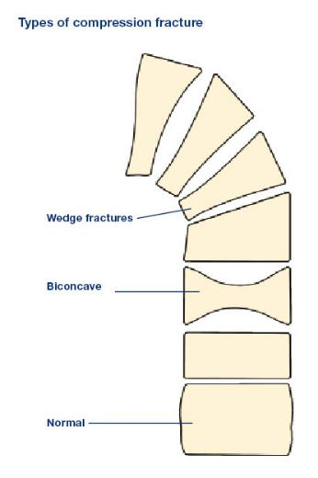
What effects do fragility fractures have?
Pain
Disability
Loss of independence
Lack of self esteem
Notes:
Effects of fragility fractures
A broken bone can be painful and difficult at any time but the impact of fragility fractures can be devastating and cause long term disability for some people
Hip fractures commonly affect older people in their late 70s or older when other medical conditions; frailty and dependence may already be a problem and the consequences of fractures are often life changing
Vertebral fractures may result in long term back pain and disability
Those affected may also experience emotional and psychological problems including depression
The disease and its consequences, including change in body shape, may contribute to loss of self esteem.

Slide 13
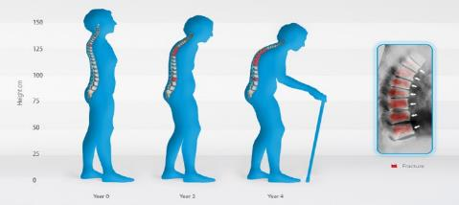
Vertebral compression fractures (multiple and severe)
Back pain – acute and chronic
Height loss and
curvature
Activities of daily living affected; eating, breathing and mobility
© IOF developed with Prof. Dieter Felsenberg for Stop the Stoop campaign
Notes:
Vertebral compression fractures
Vertebral compression fractures do not always cause symptoms although sometimes they cause severe pain that requires strong pain relieving drugs.
The acute pain following vertebral fracture usually lasts for a period of 6-12 weeks
Multiple fractures in the spine can cause significant height loss and curvature of the spine with postural changes causing pressure on the nerves; ligament strain; muscle spasm and long term pain problems as well as body shape changes such as a protruding stomach
Sometimes shortening of the trunk leads to problems with activities of daily living such as breathing; continence and mobility problems

Slide 14
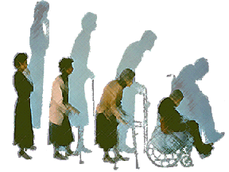
Vertebral compression fractures (multiple and severe)
I look like I’m pregnant
Nothing can be done about the pain
My ribs are pressing on my pelvis
I’ve lost
12 inches
I see my mothers distress and wonder if I will be there one day
My body shape has completely changed
My clothes won’t fit
I must have broken every bone in my body
It’s just old age
Image reprinted with permission from Medscape.com, 2011
Notes:
Vertebral compression fractures
Although most of those with compression fractures return to a good quality of life there can be unresolved longstanding effects
Some of the comments made by members of the National Osteoporosis Society and users of the charity’s helpline are listed in this slide

Slide 15
A broken hip can lead to serious disability
Admitted to nursing home
Restricted driving & shopping
Difficulty with daily activities
Unable to walk independently
0
20
40
60
80
100
Cooper. 1997
% affected within 1yr
Notes:
Impact of broken hip
A broken hip can have a major impact on all aspects of life. One study showed that one year after the fracture:
40% were unable to walk independently
80% were still unable to do basic tasks like driving or shopping
60% were still having problems with other activities of daily living
Many people are unable to return to independent living and often people need to give up their homes and move to sheltered accommodation
The study showed 20% are admitted to a nursing home following a hip fracture
It goes without saying that losing the ability to live independently is devastating.
In a separate study 80% of older women said they would rather die than experience the reduced quality of life that follows a serious hip fracture and subsequent admission to a nursing home
Salkeld G, Cameron, I. D., Cumming, R. G., Easter, S, Seymour J, Kurrle, SE, and Quine, S. Quality of life related to fear of falling and hip fracture in older women: a time trade off study. British Medical Journal 320[7231], 341-46. 2000.
Cooper, C. "The crippling consequences of fractures and their impact on quality of life." American Journal of Medicine 103.2A (1997): 12S-7S.

Slide 16
The impact of fractures on health and social services
Every year in the UK:
300,000 osteoporotic fractures
Over £2.3 billion per year on hospital and social care costs for hip fracture alone -
(approx. £6 million/day)
Notes:
Impact of fractures on health and social services
Fragility fractures can not only have enormous personal costs for the individual but there is a significant impact on health and social services
About 300 000 fractures occur in the UK every year and the costs have been calculated as £6 million per day.
1 - Figures in 2 updated using mid-2007 population data 3 and the Hospital and Community Health Services (HCHS) pay and price inflation 06-074
2 - Torgerson D, Iglesias C and Reid DM. The economics of fracture prevention. In - The Effective Management of Osteoporosis. edited by Barlow DH, Francis RM and Miles A. 2001, p. 111-121
3 - http://www.statistics.gov.uk/statbase/Product.asp?vlnk=15106
4 - http://www.info.doh.gov.uk/doh/finman.nsf/Newsletters.

Slide 17
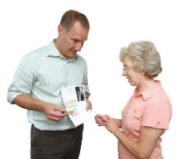
How do I know if my bones are fragile?
Signs and symptoms:
Osteoporosis is painless unless bones
break (fracture)
Fragile bones may break easily without too much force
Significant height loss and curvature of the spine may indicate compression fractures
Notes:
How do you know if you have fragile bones?
There are some signs and symptoms to be aware of:
As stated earlier, osteoporosis is painless unless a fracture occurs
A fracture following a fall or minor trauma suggests that the bones may be fragile
Significant height loss and curvature of the spine may indicate compression fractures have occurred in your spine although other conditions including spinal arthritis can also cause these symptoms.

Slide 18
How do I know if my bones are fragile?
Risk factors will make fragile bones more likely
A bone density scan will indicate if bones are less dense than average, but it is not needed by everyone
Notes:
How do I know if my bones are fragile?
There are also a number of significant risk factors associated with osteoporosis and fractures
A bone density scan will indicate if bones are less dense than average but will not be useful for everyone
Blood tests might be needed to eliminate other causes of osteoporosis or fracture.

Slide 19
Risk factors for osteoporosis and fractures
Age
Race
Gender
Some medicines - e.g. glucocorticoids (‘steroids’), breast and prostate cancer drugs
Notes:
Risk factors for osteoporosis
There are many factors that increase the risk of having osteoporosis and fragile bones:
Bones get more fragile as we get older
There are also racial differences – people of black Afro Caribbean origin have larger denser bones than Caucasians or Asians
Women lose bone more rapidly at the menopause and live longer than men so have a higher lifetime risk of fracture
Some drugs prescribed for other medical conditions such as glucocorticoids and breast cancer/prostate cancer drugs can increase fracture risk

Slide 20
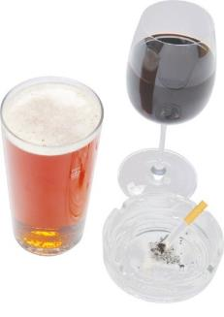
Risk factors (continued)
Some medical conditions e.g. rheumatoid arthritis and early menopause
Medical conditions causing immobility, affecting food absorption, or affecting hormone levels
Low body weight
Family history
Current smoking
Alcohol more than 3 units daily
Bones have already broken easily
Notes:
Risk factors for osteoporosis and fractures
Some medical conditions such as rheumatoid arthritis and early menopause increase osteoporosis and fracture risk
Any condition that causes long term immobility or
Affects the way we absorb food such as Crohn’s disease or coeliac disease can increase osteoporosis risk; some conditions such as anorexia nervosa and premature menopause, not only deprive the body of essential nutrients (anorexia nervosa) but reduce levels of sex hormones that help keep bones strong
Low body weight makes osteoporosis and fragility fractures more likely
Genetic factors are also important – some families have a strong family history and if your parents broke their hip easily you are more at risk
Current smoking and
Alcohol intake above 3 units daily will increase the risk of fragility fractures
Bones have already broken easily

Slide 21
One ‘fragility fracture’ increases the risk of a second
After a first fracture:
23% of all further fractures occurred within 1 year
54% of all further fractures occurred within 5 years*
*Clinical subsequent fractures cluster in time after first fractures; (2009) van Geel TA, van Helden S, Geusens PP, Winkens B, Dinant G
-
Notes:
If you have one ‘fragility fracture’ the risk of having another is particularly high especially in the following five years:
A population-based study in 4140 postmenopausal women, aged between 50 and 90 years. A total of 924 (22%) women had a first fracture and 243 of these (26% of 924) had a subsequent fracture.
After a first fracture, 23% of all subsequent fractures occurred within 1 year and 54% (more than half) within 5 years
It’s important, therefore, for the doctor to prescribe a drug treatment if it is needed as soon as possible after the first fracture

Slide 22
Fracture and quality of life over the life span
Effects on life quality
Hip fracture
Spinal fracture
Wrist fracture
Get assessed and treated here!
50
60
70
80
90
Age
Notes:
Osteoporotic fractures have a greater impact on quality of life as we age.

Slide 23
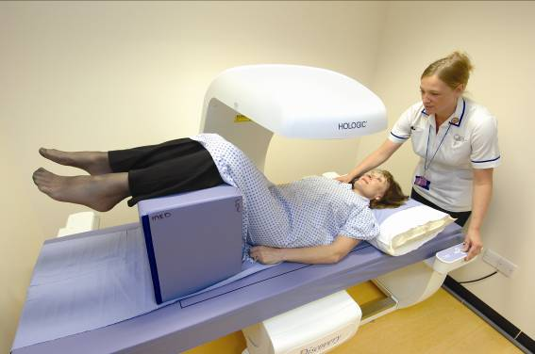
Osteoporosis diagnosed on a scan
Bone density scanning of hip and spine:
dual energy X-ray absorptiometry (DXA)
Notes:
Osteoporosis diagnosed on a scan
The current ‘gold standard’ for measuring the density of bone and diagnosing osteoporosis is DXA (dual energy x ray absorptiometry) scanning
Most scanners measure a number of spinal bones and one hip (axial scan)
The scan uses low dose radiation; is painless and silent and involves lying on a bed for a few minutes.
The results come up on a computer screen.
Scanners are mainly used to measure the quantity of bone (bone density); sometimes they will identify a compression fracture if it is in the area scanned
Newer scanners are set up to specifically identify fractures
Some DXA scanners, called peripheral scanners, measure bone density in the heel or forearm
There are other scans available using ultrasound.
Although these ultrasound scans give some information about your risk of fracture they are not as good as DXA scanners.

Slide 24
Osteoporosis on a DXA bone density scan
NORMAL
-1 SD
LOW BONE MASS
(OSTEOPENIA)
-2.5 SD
NO FRACTURE
(OSTEOPOROSIS)
WITH FRACTURE
(SEVERE OSTEOPOROSIS)
WHO Study Group 1994
Notes:
Osteoporosis on a DXA bone density scan
Osteoporosis was defined by the World Health Organisation in 1994 based on measurements obtained from bone density scans
When you have a scan your results are compared with a reference measurement made in young healthy women
If your results are 2.5 standard deviations (a statistical measure) below this reference measurement than you are diagnosed as having osteoporosis
If you have also experienced a fracture you are said to have severe osteoporosis
WHO Study Group (1994). Assessment of fracture risk and its application to screening for post menopausal osteoporosis. 843: 1-129. WHO Technical Report Series.

Slide 25
What makes a fragility fracture likely?
Fragility fractures
Poor bone strength
Risk of falling (except fractures in the spine)
Impact of fall
Notes:
Risk of fragility fracture
The risk of having a fragility fracture will depend on the strength of our bones as well as whether a fall occurs (although vertebral compression fractures can happen spontaneously, hip and wrists and other fractures are associated with falling)
The impact of the fall will also affect whether a fracture occurs
So falling on a hard surface for example may be more likely to result in fracture than falling on a soft surface
Bone density measurements tell us how much bone there is, and gives a good idea about your underlying risk of fracture; however it is not itself a measurement of bone strength.
Many other factors will contribute to bone strength and identifying these factors will help build up a more complete picture of bone strength and therefore risk of fracture.

Slide 26
Your risk of a fragility fracture
Falls
Alcohol > 3 units
daily
Other diseases
& conditions
Rheumatoid
arthritis
Parent broke their hip
Smoking
Glucocorticoids
Bone density
Age
Previous
fragility
fracture
Body mass index
Notes:
Risk of fragility fracture
All these factors can be put together to provide a more accurate assessment of your risk of fracture
Such ‘fracture risk assessment’ is most useful when doctors are making decisions about whether a drug treatment is needed to reduce fracture risk
Those with a high fracture risk will be prescribed drug treatments

Slide 27
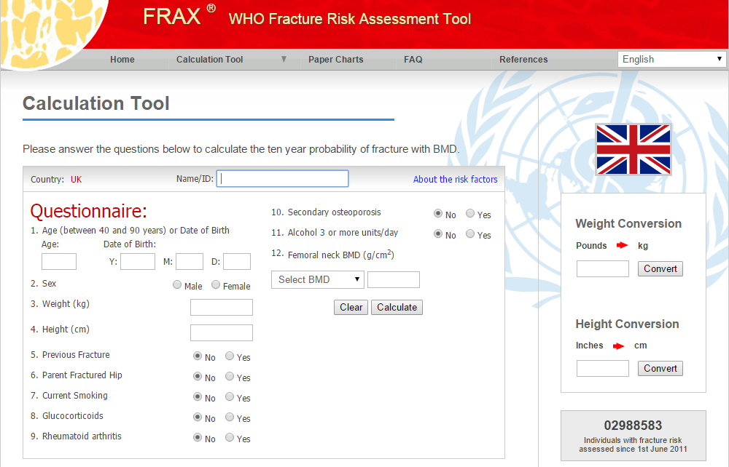
Notes:
FRAX
In 2008 the World Health Organisation approved a questionnaire or ’tool’ (available on the internet) called FRAX.
This puts together all the proven risk factors and calculates a persons risk of a fragility fracture in the next 10 years.
In the UK a number of experts (the National Osteoporosis Guideline Group) have created a guideline using the results of the FRAX tool to help clinicians decide if a drug treatment is needed
As well as FRAX doctors might also use a tool called Qfracture to assess fracture risk
www.shef.ac.uk/FRAX/
http://www.shef.ac.uk/NOGG/
http://www.qfracture.org/

Slide 28
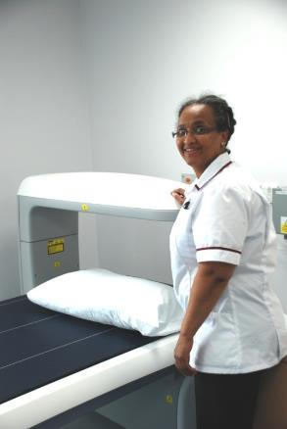
Bone density (DXA) scanning
Useful:
For those with significant risk factors when it is uncertain if bones are fragile
to decide whether drug treatment is necessary
May be useful:
In those taking drug treatments
to see if a treatment is working (this may not always be helpful)
Not useful:
As a ‘screening’ tool
Notes:
Bone density scanning
Measuring bone density can be very useful for those with a significant risk factor to help decide if they are at high enough risk to need treatment
Measuring bone density in the absence of risk factors is currently not recommended
Bone density measurement can be helpful in determining whether an individual who experiences a fracture has underlying osteoporosis, though for some people where the diagnosis is clear it is not always necessary
Many people ask whether they need repeat scans to see if a treatment is working
Although repeat scans (usually after a couple of years) can provide some information they can not prove conclusively whether a treatment is working or not

Slide 29
How can the risk of fragility fractures be reduced?
Fragility fractures
Drugs,
including Vit D
Flooring,
hip protectors
Poor bone strength
Falls
(except fractures in the spine)
Impact of falls
lack of padding
Lifestyle
Exercise Healthy eating
Sunlight Healthy pregnancy No smoking/excessive alcohol
& Other interventions for falls prevention
Notes:
Reducing risk of fragility fractures
We saw on a previous slide how a combination of bone strength; the risk of falling and the impact of a fall can all affect the chance of us having a fragility fracture
However research has now proven that these fractures are not inevitable and there are ways that this risk can be reduced
First, there are lifestyle changes that we can make that may improve bone density and strength and also make falling less likely
Secondly there are also drugs that can improve the strength of bones and may also, in the case of vitamin D supplements, make falling less likely
And then there are other factors such as wearing special hip protector pants or changing types of floor surface that might also reduce the impact of a fall although research is still needed to prove whether these will work

Slide 30
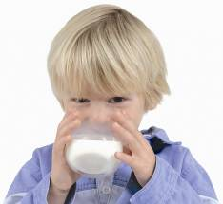
What can I do to keep my bones strong and prevent fractures?
Healthy, balanced, calcium-rich diet
Weight-bearing exercise
Maintain appropriate body weight
Not smoking
Not excessive alcohol
Adequate vitamin D
Notes:
Maintaining healthy bones and preventing fractures
Eating healthy foods with adequate calcium will provide all the nutrients needed by the skeleton
Weight or load bearing exercise, when the body’s weight is pulling on the skeleton, this will ensure that the remodelling of bone is effective
Inactivity and immobility leads to more bone worn away than is rebuilt, with loss of bone density and strength as a consequence
Low body weight reduces the load on the skeleton and may result in reduced bone density
Excessive weight loss and eating disorders such as anorexia nervosa can also affect hormone levels with low levels of oestrogen increasing the risk of osteoporosis and fractures
Smoking affects the bone building cells and increases fracture risk
More than 3 units of alcohol a day increases fracture risk. Alcohol has adverse effects on bone and disrupts the way bones work
Safe exposure to sunlight helps maintain vitamin D levels which are important in maintaining bone health

Slide 31
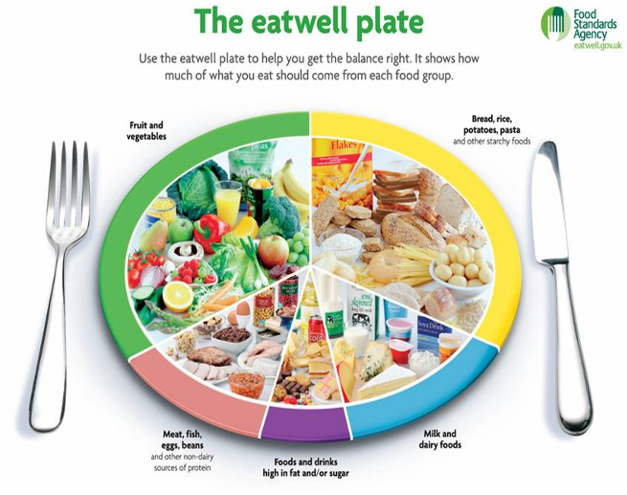
© Crown copyright 2011.
Department of Health in association with the Welsh Assembly Government, the Scottish Government and the Food Standards Agency in Northern Ireland.
Notes:
The Eatwell Plate
Healthy eating of foods from all the main groups should provide all the nutrients needed for strong bones e.g.
protein for the growing (and aging) skeleton from meat, fish or alternatives;
at least 5 portions of fruit and vegetables for B,C and K vitamins as well as other nutrients and to keep the correct balance of acidity/alkalinity in the blood;
plenty of starchy foods like pasta, bread, potatoes or rice with some whole grains included
Milk and dairy products unless they are excluded by choice when alternatives will be needed
Only small amounts of salt, refined sugar and saturated fats
5g or more of saturated fat per 100g is excessive
10g or more of sugars per 100g is excessive
Adults should eat no more than 6g of salt a day – that's around one teaspoon (Food labels sometimes give the figure for sodium - 2.4g of sodium chloride is equal to 6g of salt.)
Oily fish and egg yolks contain some vitamin D but most is obtained from sunlight.

Slide 32
UK recommended daily calcium intake (mg): COMA report 1998
Children aged 7-12 years | 550
Teenagers – males | 1000
Teenagers – females | 800
Adult males | 700
Adult females | 700
Pregnant women | 700
Lactating women* | 1250
*May not be necessary
A daily intake of about 1000mg may benefit those with osteoporosis on treatment,
but excessive amounts taken as a supplement could be harmful
Notes:
Calcium intake
The UK government has recommended how much calcium we need to get from our food in a report that came out in 1998
It identified an intake of 700mg daily as sufficient for all adults
While there is on-going research, the general consensus at present is that if people have osteoporosis and are on an osteoporosis drug treatment, they may benefit from an intake of about 1000 mg daily

Slide 33
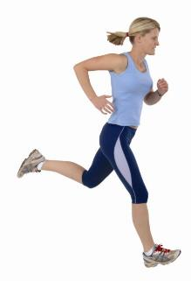
Exercise
Load/weight-bearing exercise reduces bone loss and improves bone strength
High impact exercise in early years to increase bone mass
Notes:
Exercise
Exercise also has an important role to play in keeping our bones strong
Bone is a living tissue and reacts to increases in loads and forces by growing stronger
Load or weight bearing exercise means any exercise where the body’s weight is pulling on the skeleton - so brisk walking is load bearing but swimming is not because the weight of the body is supported by the water
This is especially important for the growing skeleton when high impact exercise such as running and jogging can help build bone density especially in the spine and hips

Slide 34
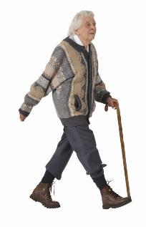
Exercise
Exercise to prevent falls - increase muscle strength and improve balance
Being active in later life prevents fractures – on your feet for at least 4 hours a day
Exercise improves mood, mental health and well being, and prevents or delays many other medical conditions
Choose something you enjoy and keep doing it!
Notes:
Exercise
As we get older, exercise to prevent falls is important for preventing many types of fracture - exercise needs to specifically improve muscle strength and balance if it is going to be effective
Research has also shown that even keeping active in later life – being on your feet for at least four hours a day- will reduce the risk of fractures
An important motivator is that exercise has multiple benefits. It improves mood and general well being and has also been proven to reduce the incidence of many diseases and medical conditions
A key message is to choose something you enjoy and to keep doing it

Slide 35
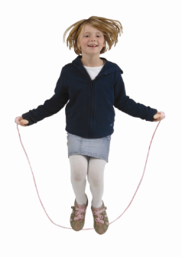
UK Government recommendations for physical activity
Adults: 30 minutes of moderate-intensity physical activity at least five days a week (or 150 minutes or more in total)
Children: 60 minutes of moderate-intensity physical activity each day
Notes:
UK Government recommendations for physical activity
The UK Department of Health currently recommends 30 minutes of moderately intense activity on at least five days of the week
Children are advised to take 60 minutes of exercise every day

Slide 36
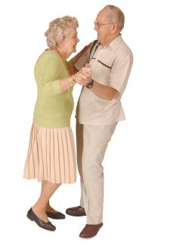
UK Government recommendations for physical activity
Older adults: 30 minutes of moderate-intensity physical activity at least five days a week (or 150 minutes or more in total)
….PLUS strength and balance exercises at least twice a week
Notes:
UK Government recommendations for physical activity
2011 recommendations reflect current research and suggest older people should include strength and balance exercises to reduce the risk of falling

Slide 37
Vitamin D
Helps the body use calcium and is essential for healthy bones
Sunlight provides the vitamin D we need
Daily sunlight exposure between May and September increases vitamin D levels
Stored by the body for the winter months
Notes:
Vitamin D
Vitamin D is essential for healthy bones
Sunlight is the best natural source of Vitamin D
Exposure to sunlight every day between May and September will increase Vitamin D levels
Your body stores vitamin D for the winter months.

Slide 38
Vitamin D
10 minutes of sun exposure to bare skin once or twice/day
Important not to burn
Make sure that you are actually outside
Some people need supplements:
10-20µg (micrograms) daily –
e.g. pregnant women; those who don’t get sunlight exposure; older frailer people
Notes:
Vitamin D
You should try to get 10 minutes of sun exposure to your bare skin, once or twice a day (depending on skin type) without sunscreen
On cloudy days, it can take a little longer
Always take care not to burn, especially during the strong sunshine in the middle of the day
Babies and children have very sensitive skin and need careful protection
Those with fair or sensitive skin need to be careful not to redden or burn their skin and will need to restrict exposure
Make sure you are outside – glass prevents the ultra violet rays reaching your skin
Pregnant women; those who don’t get sunlight exposure; older frailer people; those on antiepileptic drugs may need supplements
A daily dose of 10 - 20 micrograms (µg) (= 400 - 800 IU) is usually sufficient

Slide 39
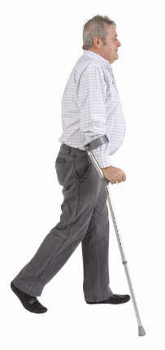
Keeping steady and safe as we get older to prevent hip fracture
Medical conditions – get them diagnosed and properly treated
Medicines – get them checked Do you need them all? Get a Review
Vitamin D – supplements?
Notes:
Keeping steady and safe
Note to speaker: Slide 39 and 40 are the ‘falls prevention slides’. For a general public audience it is advised to avoid overstating the term ‘fall prevention’.
The ‘Help the Aged’ report ‘Don’t mention the ‘F’word’ (2005) showed people were reluctant to think of fall prevention as relevant or serious and resented the negative, patronising association
Although only 5% of falls in older people result in fractures, nearly all hip fractures are the result of a fall
Preventing falls has become an important focus for preventing fractures
Some hospitals have special fall prevention clinics to help those at risk
Some medical conditions (as well as poor eyesight) can cause falls and need to be identified and treated
Older people are often taking many medications – some can cause drowsiness and confusion. Your doctor or pharmacist should review your medicines regularly especially if you are falling
Adequate vitamin D may be important to prevent falls – older frailer people may need supplements
Youm T, Koval KJ, Kummer FJ and Zuckerman JD., (1999) Do all hip fractures result from a fall? Am J Orthop 28: 190-194.

Slide 40
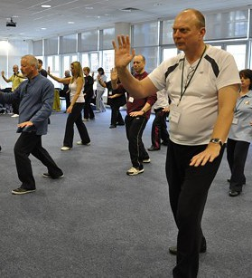
Keeping steady and safe as we get older to prevent hip fracture
Keep fit and active as you get older
Specific exercises help to improve balance and muscle strength
Tai Chi
Safe home environment
Hip protectors?
Notes:
Keeping steady and safe
Keeping fit as you age is important but specific exercises to improve balance and muscle strength will help to prevent falls
Tai Chi may reduce the risk of falling
Simple, practical changes at home such as good lighting on stairs and wearing well fitting shoes may be helpful
Special pants with protective shells (hip protectors) to prevent the hip bone breaking may be useful although the research is inconclusive

Slide 41
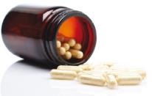
Drug treatments to strengthen bones and prevent fractures
Doctors decisions should be based on the likelihood of having a fragility fracture in the next 10 years
For about 5 years but may be long-term
Usually later in life when the risks are highest
Government or local guidelines may affect prescribing
Notes:
Drug treatments
Drug treatments can reduce the risk of fractures by 50%* but are generally only prescribed to those at high risk of fracture in the next 10 years
Medicines are often prescribed for about 5 years although in those at highest risk of fracture treatment may be needed for many years
Older people are most at risk of bone fragility and fractures so treatments are most useful in later life
The government body - NICE – the National Institute for Health and Care Excellence - produces guidance on which drugs a doctor can prescribe and there may also be local guidelines which affect the use of some medicines
*full list of relevant studies on National Osteoporosis Society website - Facts and Figures document.
http://www.nos.org.uk/NetCommunity/Page.aspx?pid=328&srcid=312

Slide 42
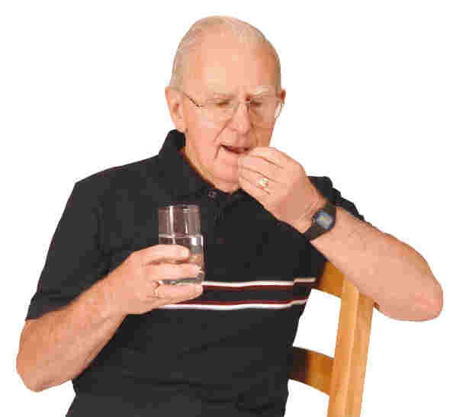
Drug treatments: bisphosphonates
Alendronic acid or alendronate (Fosamax and Fosamax once weekly)
Risedronate (Actonel and Actonel once weekly)
Ibandronate (Bonviva)*
Zoledronate (Aclasta)*
Notes:
Drug treatments
There is a range of drug treatments available in the UK and prescribed usually to reduce the risk in those with a high risk of fracture
The group of medicines called bisphosphonates are the most commonly prescribed
Most drug treatments are given as tablets that you take daily, weekly or monthly
Some drugs (indicated by an asterisk*) are available as an injection or are given in hospital via a ‘drip’ - usually prescribed only by a specialist
They are generally only prescribed by a specialist so you would need to be referred for a hospital appointment
Alendronic acid is the generic (non branded) drug most likely to be prescribed but there are other options available if this drug is not tolerated
Recently, risedronate & ibandronate has become available in a generic form

Slide 43
Drug treatments: others
Raloxifene (Evista)
Denosumab (Prolia)*
Parathyroid hormone (PTH) - (teriparatide - Forsteo)*
Strontium ranelate (Protelos)**
Hormone replacement therapy (HRT)
Calcium and vitamin D supplements
Calcitriol (Rocaltrol) (active form of vitamin D)
Notes:
Drug treatments
There are other medicines, not in the bisphosphonate family, that might be considered if alendronic acid is not suitable for you
**Use of strontium ranelate is restricted to those with severe osteoporosis / with no history of heart disease & blood clots / when no other osteoporosis medication can be taken / prescribed by a doctor ‘experienced in osteoporosis’
(Single asterisk* indicates a drug usually prescribed by a specialist and given as in injection or via a ‘drip’)

Slide 44
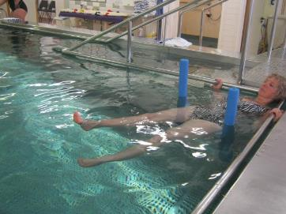
Living with broken bones: help after vertebral compression fractures - 1
Pain relieving drugs
Physiotherapy and specific exercises
Corsets?? (short-term)
Hydrotherapy – warm water
Complementary therapies e.g. acupuncture
Heat and cold / gentle massage
Notes:
Living with broken bones
Vertebral compression fracture, as I have explained, can cause long term pain problems
However there are many different strategies available to help
Pain relieving drugs may be needed for acute pain – paracetamol may be prescribed with opiates such as codeine
A physiotherapist can prescribe specific exercises to build muscle strength, support the spine and reduce pain
Corsets or spinal braces can sometimes be used for short periods to help with pain although long term use may cause muscle weakness
Hydrotherapy – exercise in warm water may reduce muscle spasm and increase confidence
Some people choose to try complementary therapies such as acupuncture
Hot and cold compressing or gentle massage may provide relief

Slide 45
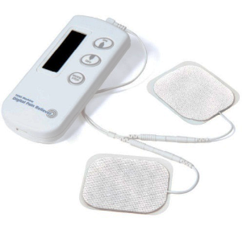
Living with broken bones: help after vertebral compression fractures - 2
TENs machines
Pain clinics / management courses
Self management classes (e.g. Expert Patient)
Percutaneous vertebroplasty / balloon kyphoplasty
Charity’s website, publications and Helpline
Notes:
Living with broken bones
TENS machines
A referral to a pain clinic offers different strategies to help manage pain
Self management classes are available in some regions
Percutaneous vertebroplasty or kyphoplasty is a surgical technique when a cement is injected into the affected vertebrae to reduce severe pain not relieved by other approaches. The evidence that this is effective is conflicting
The National Osteoporosis Society provides further information on its website and in the booklet ‘All about Osteoporosis’ and in other leaflets.

Slide 46
Living with broken bones: help after a hip fracture
Effective assessment and operation to help with healing
Adequate pain relief
Physiotherapy and rehabilitation
Return to own home if at all possible
Appropriate social care
Osteoporosis and falls risk assessment
Drug treatment to reduce risk of further fracture
Help to prevent further falls
Notes:
Living with broken bones
A broken hip can as, I have explained, have a devastating impact on quality of life
Specific strategies are essential to ensure someone affected has the greatest chance of making good recovery
An operation is usually needed after a broken hip to either mend the hip bone or replace part or all of the top of the hip bone
If someone is medically fit this operation should happen quickly (within 48 hours) to give the best chance of a good recovery
Medicines to relieve pain must be reliable and effective to ensure comfort, confidence and early rehabilitation
Health and social professionals need to work together to ensure rehabilitation and a return to independent living where possible
Assessment of osteoporosis and bone fragility is important so that osteoporosis drug treatments can be prescribed to prevent further fractures
Fall prevention advice may also be useful and some hospitals have specific clinics to provide help
British Orthopaedic Association Blue book ‘The care of patients with fragility fracture’ 2007

Slide 47
Summary 1
Osteoporosis is a common condition that can lead to painful and disabling fractures
Those at risk need appropriate assessment of their bone fragility
A healthy lifestyle can help to build and maintain strong bones and prevent fractures
Notes:
In summary:
Osteoporosis is a common condition that can lead to painful and disabling fractures
Those at risk need assessment of their bone fragility
Everyone can help themselves by ensuring they have a healthy lifestyle to maintain strong bones and prevent fractures

Slide 48
Summary 2
Drug treatments to reduce the risk of fractures are available for those at the highest risk
Help and pain management after fractures are essential so that people regain a good quality of life and further fractures are prevented
Notes:
Summary cont:
There are now safe and effective drugs and it is essential these are available for those at the highest risk of fracture
After fracture, help and pain management prevent further fractures and maintain life quality

Slide 49
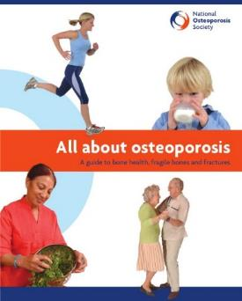
Free publications and website resources
The National Osteoporosis Society produces a FREE 68 page book covering everything you need to know about osteoporosis
Contents of the book also appear on the website
To order a copy go to:
www.nos.org.uk
or call 01761 471771
Notes:
All about osteoporosis - our main ‘core’ publication containing clear explanations of osteoporosis and bone health related issues. Covers:
What is osteoporosis
Prevention / lifestyle ways of improving bone health & strength
Diagnosis and risk factors
Osteoporosis drug treatments overview
Living with broken bones – including managing pain from a fracture.

Slide 50
Free publications and website resource
To order any of the publications,
ring General Enquiries
on 01761 471771
Notes:
A range of free booklets, leaflet and information sheets available from the National Osteoporosis Society covering a range of osteoporosis related issues
Ring General Enquiries on 01761 471771

Slide 51
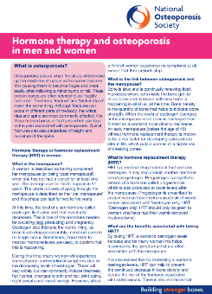
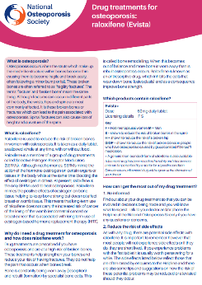
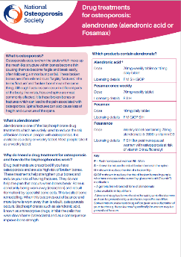
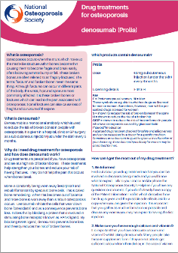
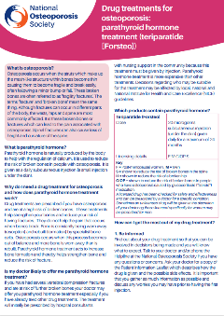
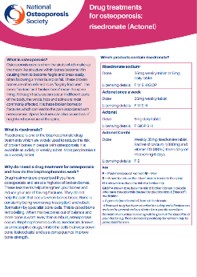
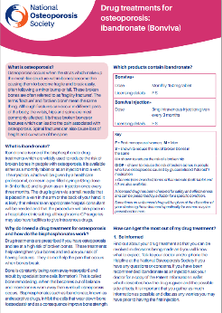
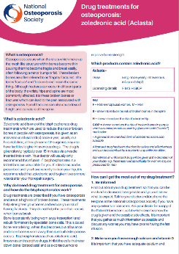
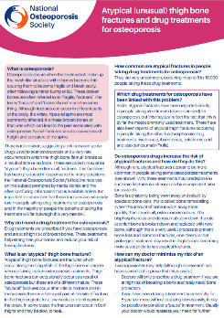
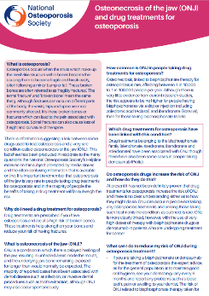
‘Drug treatments for osteoporosis’ range
Notes:
A range of factsheets which are supplementary to information in ‘All about osteoporosis’ booklet.
They can be ordered from General Enquiries or printed off at home or the GP clinic from the website

Slide 52
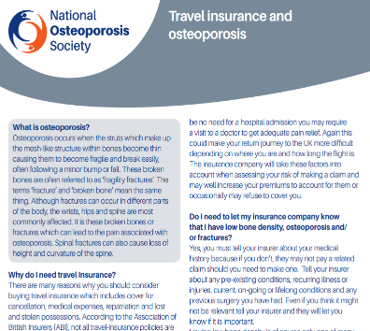
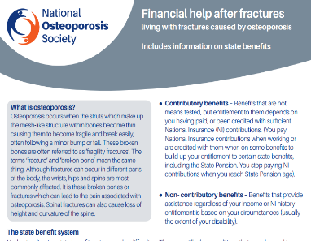
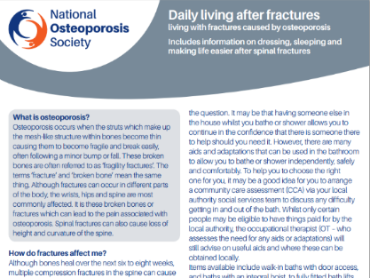
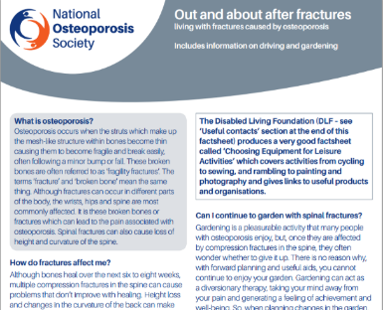
‘Living with Fractures’ range
Notes:
A range of fact sheets covering issues around living with fractures and especially spinal fractures including managing pain

Slide 53
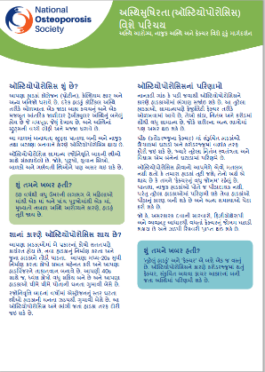
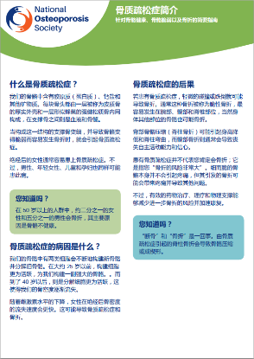
‘Introduction to Osteoporosis’
in 8 languages
Notes:
The small booklet ‘Introduction to osteoporosis’ is now available as a fact sheet in 8 different languages:
Bengali
Hindi
Gujarati
Urdu
Polish
Simplified Chinese
Welsh

Slide 54
Free publications and website resources
Bone Health Quiz on the ‘Are you at risk’ page of the website
Calcium calculator on the ‘Osteoporosis / Healthy Bones’ part of the website
Professional guidelines & resources on the health professionals section of the website
Primary care online resources in e-Learning & Training - Health Professionals section of the website
Notes:
Other online resources available on the charity’s website www.nos.org.uk
(Raise awareness of the website and the ‘Bone health quiz’ on the website)

Slide 55
STOP AT ONE
A National Osteoporosis Society campaign to encourage anyone over 50 who has
broken a bone to have a bone check and find out if they are at risk of osteoporosis.
Visit www.nos.org.uk/stopatone for more information and
to order posters and scratch cards to promote the campaign
Notes:
Stop at One Campaign
In 2013, the National Osteoporosis Society launched the UK-wide Stop at One campaign
The message is clear: everyone over 50 who has broken a bone should be assessed for their future fracture risk
The aim of the campaign is to raise public awareness of the risk of broken bones caused by osteoporosis, spreading a vital message and empowering people to take steps to improve their bone health
It’s hoped that this will put an end to the misery of broken bones for many thousands of people who will now Stop at One

Slide 56
The National Osteoporosis Society
The only UK-wide charity dedicated to improving the prevention, diagnosis and treatment of osteoporosis.
As an independent charity the National Osteoporosis Society can only continue to provide services with the generosity of supporters and members of the public.
Helpline: Freephone - 0808 800 0035
Notes:
The National Osteoporosis Society
Is the only UK-wide charity dedicated to improving the diagnosis, prevention and treatment of osteoporosis and fragility fractures
As an independent charity, we don’t receive any funding from the government or the NHS

Slide 57
Helpline number:
0808 800 0035
Email address:
nurses@nos.org.uk
Mail address:
The National Osteoporosis Society, Camerton, Bath BA2 0PJ
‘Ask the Nurses’ Forum:
nos.org.uk/forum
Opening hours:
Weekdays 9am to 5pm
Tuesdays 11am to 7pm
Notes:
The Helpline:
The service is provided by nurses with specialist knowledge of osteoporosis and bone health. The service is supported by a large body of scientific and medical advisers to ensure our information is based on the most accurate, independent and up to date knowledge so that you can make informed choices.
The Helpline nurses can provide you with a personal reply backed up by information provided in electronic or printed format
You can telephone 0808 800 0035 between 9am and 5pm on weekdays (excluding bank holidays). On Tuesdays, the telephone helpline is open between 11am to 7pm.
You can email nurses@nos.org.uk for a private reply. Please allow up to 5 working days to hear back from us
You can write to the nurses at the National Osteoporosis Society, Camerton, Bath, BA2 0PJ. A reply will be made within 5 working days.
You can ask a question on our ‘Ask the Nurses’ discussion forum on the website www.nos.org.uk if you are happy for a public response to be provided. Please allow up to 72 hours for a reply

